Slide 1
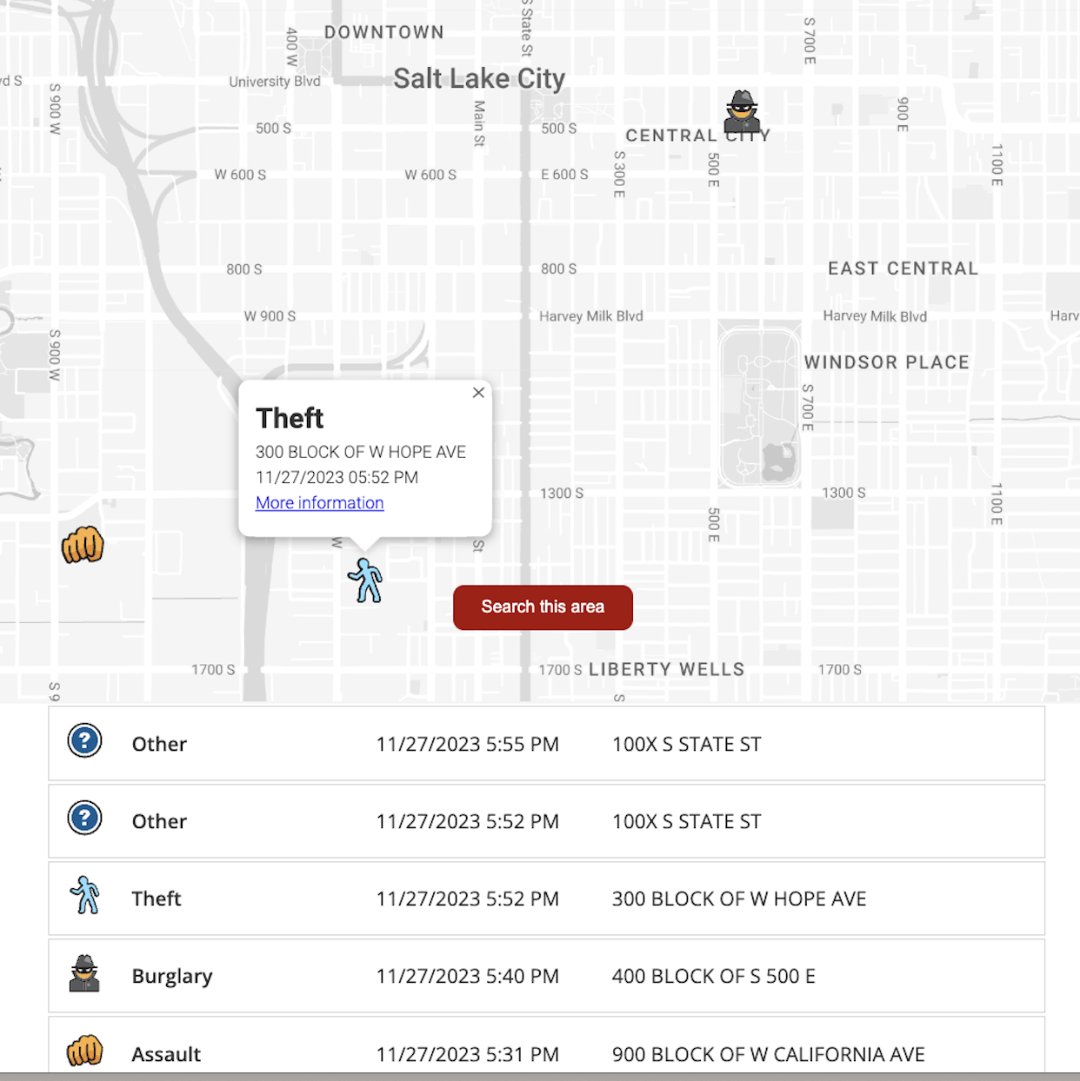
Visualizing Open Data: Public Perceptions on Privacy
Notes:
Hello everyone, today we are presenting our project: visualizing open data, public perceptions on privacy

Slide 2
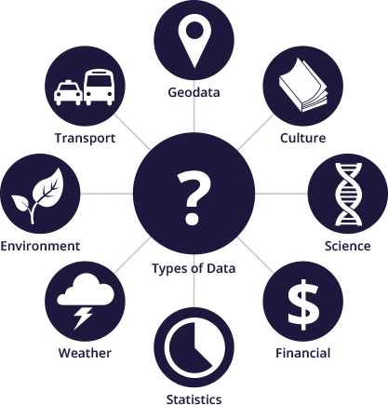
Open Data (Public Data) & Privacy
The data that are made freely available by government bodies or local collectivities ¹
Open data can be related to individuals or communities, and thus, to privacy
- Promotes accessibility, innovation, and accountability
- Empowers transparency, collaboration and informed decision making.
[1] Kassen, Maxat (1 October 2013). "A promising phenomenon of open data: A case study of the Chicago open data project"
Notes:
What exactly is open data?
There are various definitions of Open Data out there.
For our purposes, we're going to use this one: 'Open Data refers to data that are made freely available by government bodies or local collectivities.'
Open data can come in different forms and in many categories, and is often considered to have many positive implications.
【click】 Here, our focus is on open data that is related to individuals or communities—data that raises important questions about privacy

Slide 3
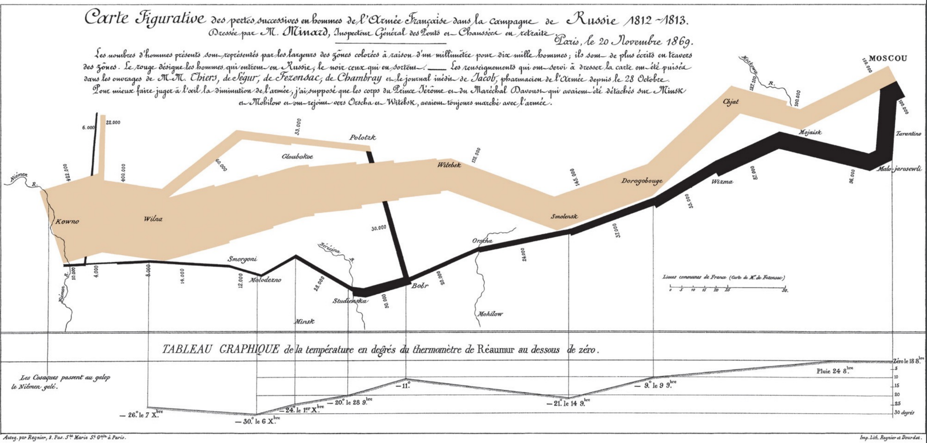
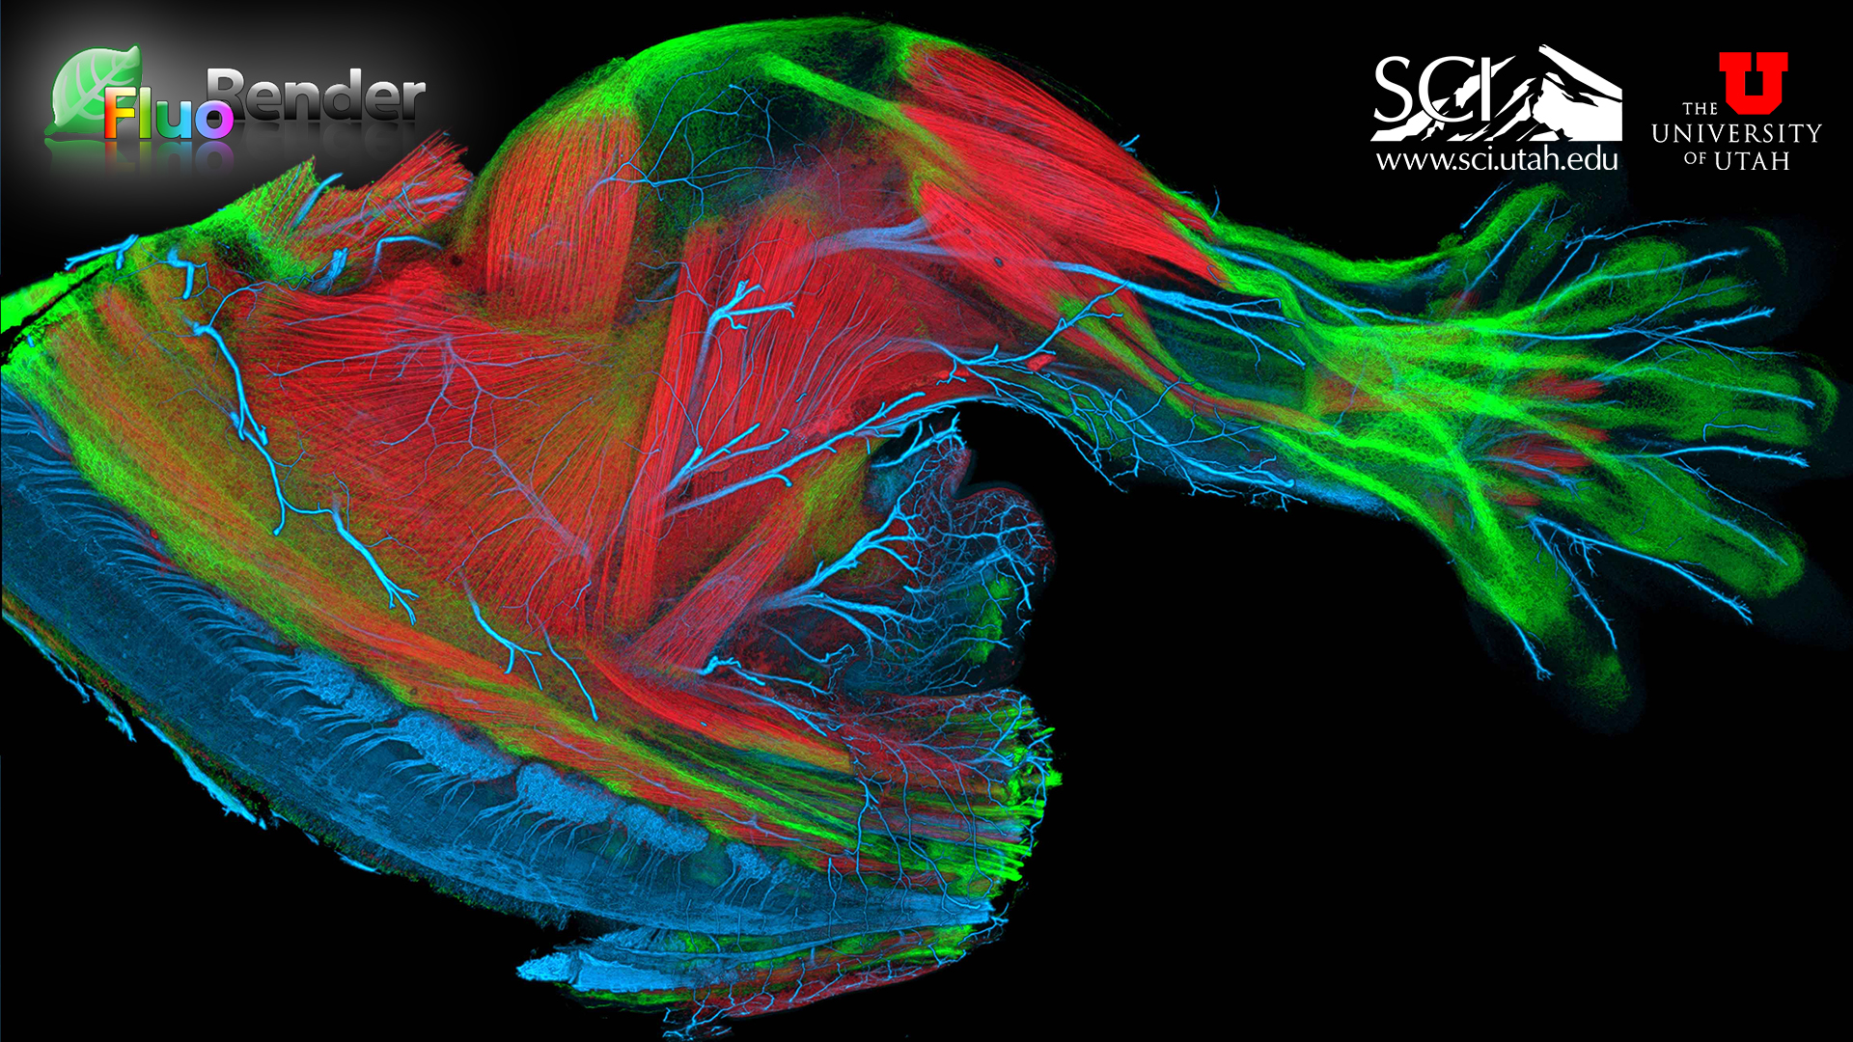
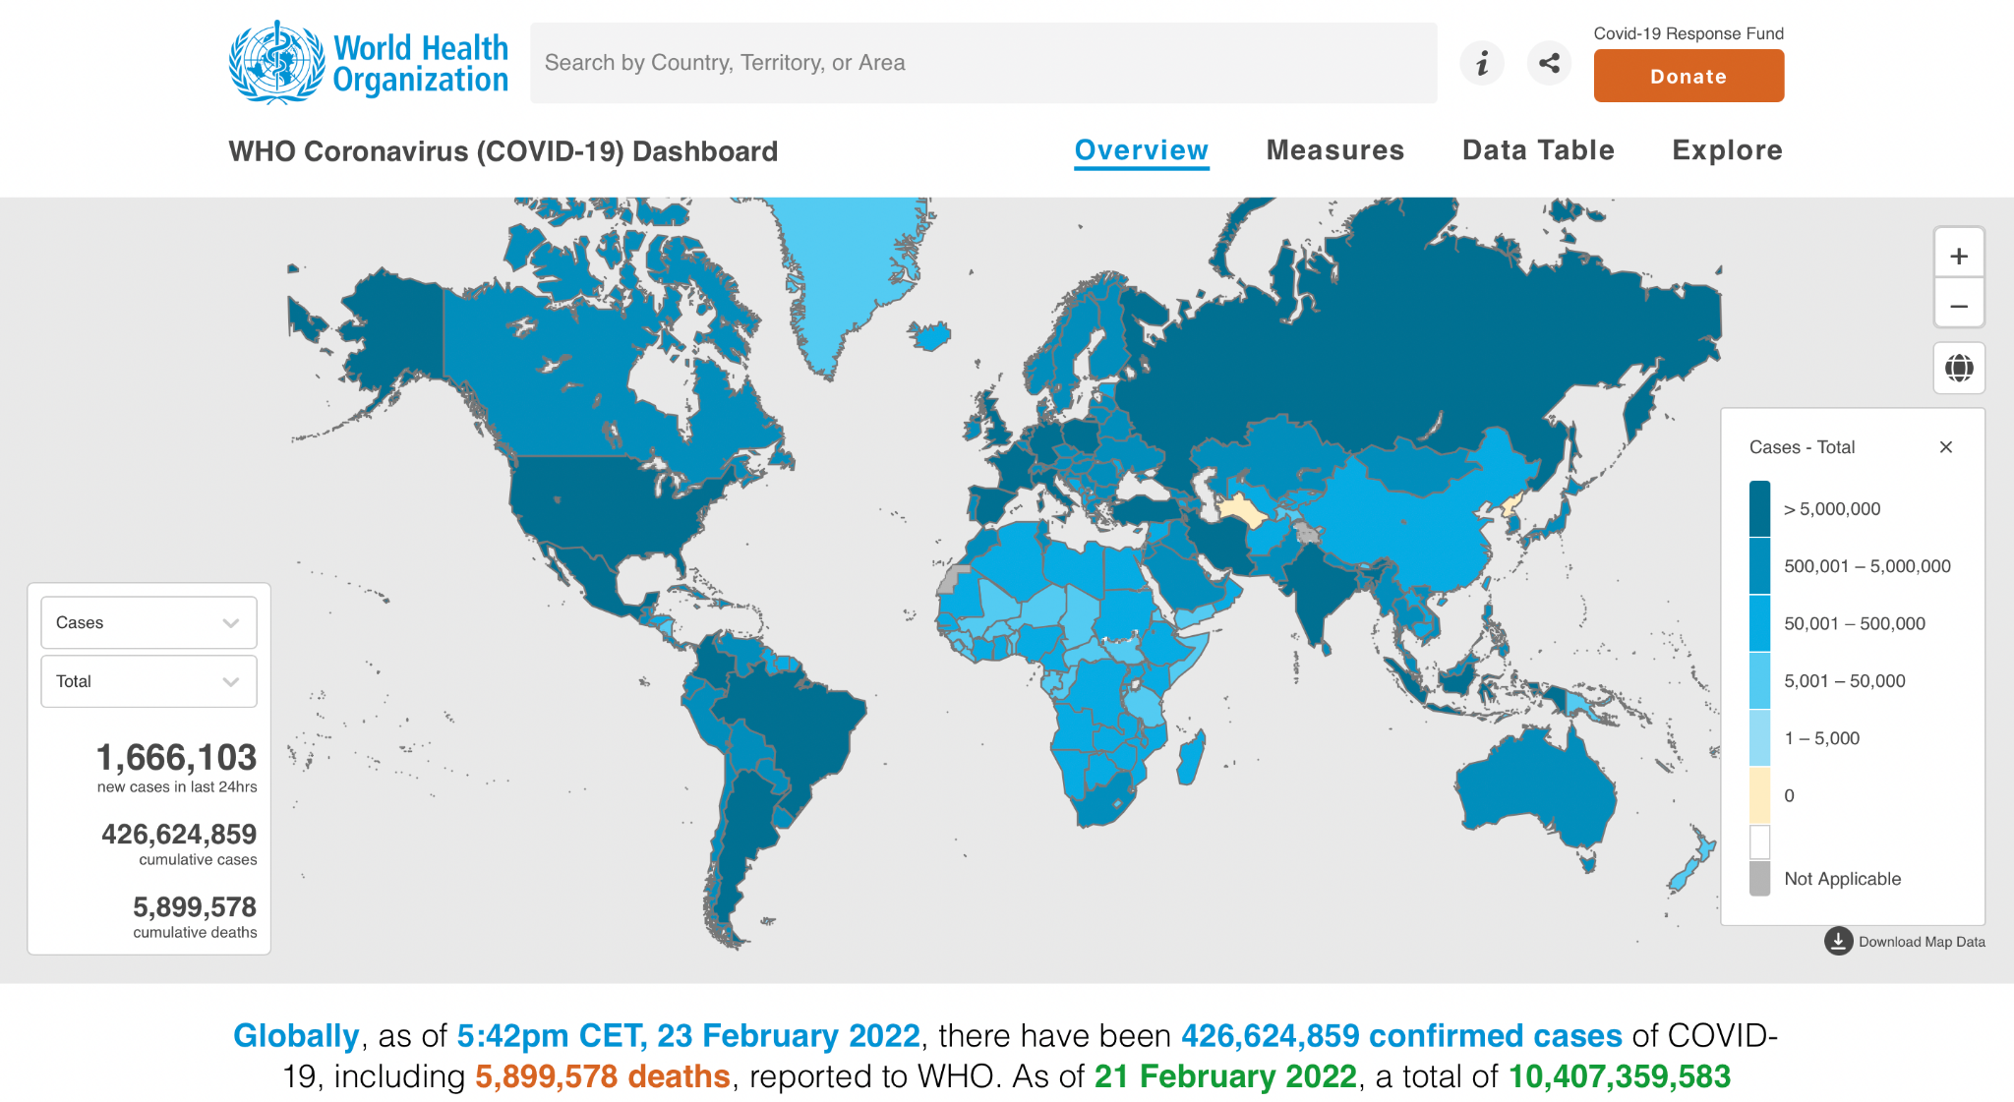
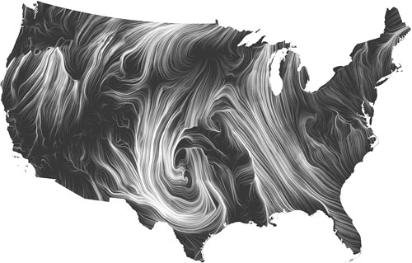
Visualization: A Tool for Enhancing Comprehension and Facilitating Ease of Access to Information
Notes:
Visualization serves as a powerful tool to enhance comprehension and simplify access to information, This are many examples such as the renowned map depicting Napoleon's Invasion of Russia, informative COVID dashboards, and illustrative representations of the circulatory system that are made here at the University of Utah. Now let’s look at a video of How visualization can be a “threat” for privacy

Slide 4

When Visualization Becomes a “Threat” for Privacy
“Newspaper sparks outrage for publishing names, addresses of gun permit holders in an interactive map”
“The names and addresses of the two counties’ permit-holding residents were obtained through the Freedom of Information Law”
Notes:
【click】
After watching this video, we can't help but wonder: the data are disclosed based on a law of freedom of information, but why are people dissatisfied with the revelation of this map?
If these data were presented in a Tableau spreadsheet, would there still be these issues?
Setting aside the societal perspectives, can visualization of public data lead to differences in perception?

Slide 5
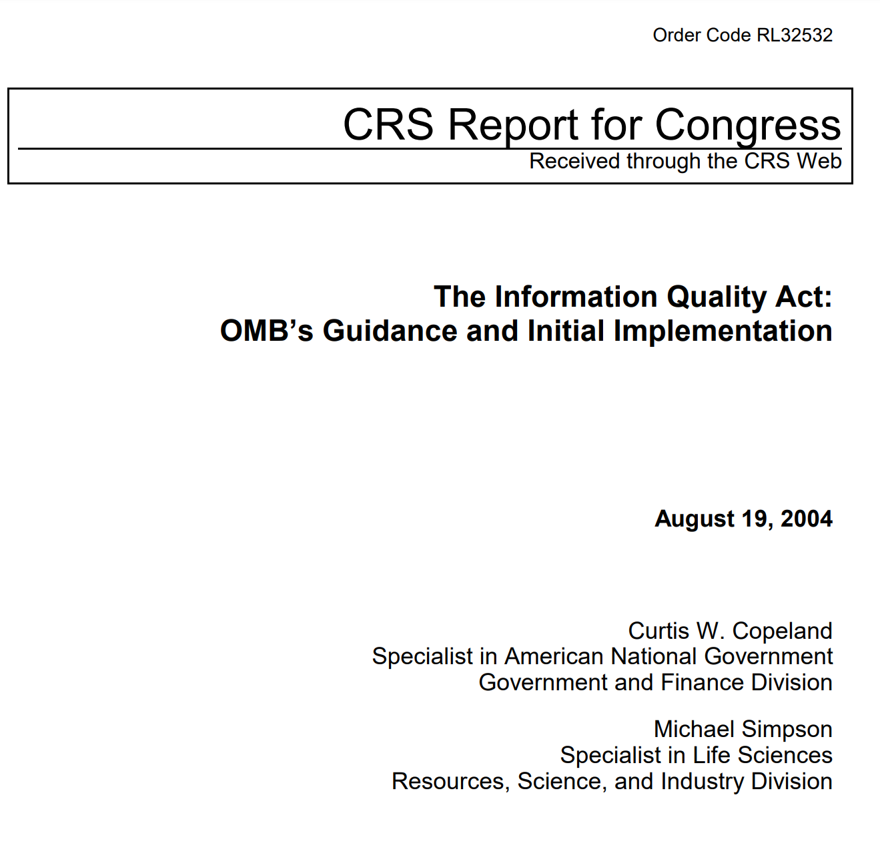



Visualization is a good tool
But…
There is a knowledge gap
for guiding the Visualization of Public Data
Information Quality Act ensures the credibility of public data
How should the visualized format look like
What is the difference between tableau data and its visualization in terms of privacy perceptions?
What is the difference between tableau data and its visualization?
Too address this…
Notes:
Visualization is good tool, but, there is a knowledge gap for guiding the visualization of public data.
【click】
There are good things like the information quality act, which ensures the credibility of public data.
【click】
But we don’t know how should the visualized format look like.
【click】
To figure out this, we will need to know, what is even the difference between tableau data and its visualization.
【click】
In our project, we narrow down this again to try to answer this question: what is the difference between tableau data and its visualization in terms of privacy perceptions?

Slide 6
Literature Review
Reviewed of 18 papers from top venue
Used Keywords: ‘visualization and privacy’, ‘accessibility to public data’, ‘open data’, ‘visualization perception’
Most of the literature highlights how visualization increases the accessibility and knowledge comprehensibility
Significant gap of research around how visualization effects the perception about privacy

Slide 7
RQ1
RQ2
RQ3
Does visualization alter the perception of open data as public or private?
What specific forms of data visualizations make individuals feel uncomfortable?
How does including private information in visualizations of open data impact people’s perception?

Slide 8
Interview Design
Semi-structured interview with 7 participants
Presented datasets in both raw data and visualization formats
Opinions on: how different forms of data can affect their perception, whether the data should stay public
Open data knowledge
Perception of open data in raw vs visualized format
Open Data Initiative
Open data knowledge & Experience
Perception of open data in raw vs visualized format
When data is personal

Slide 9
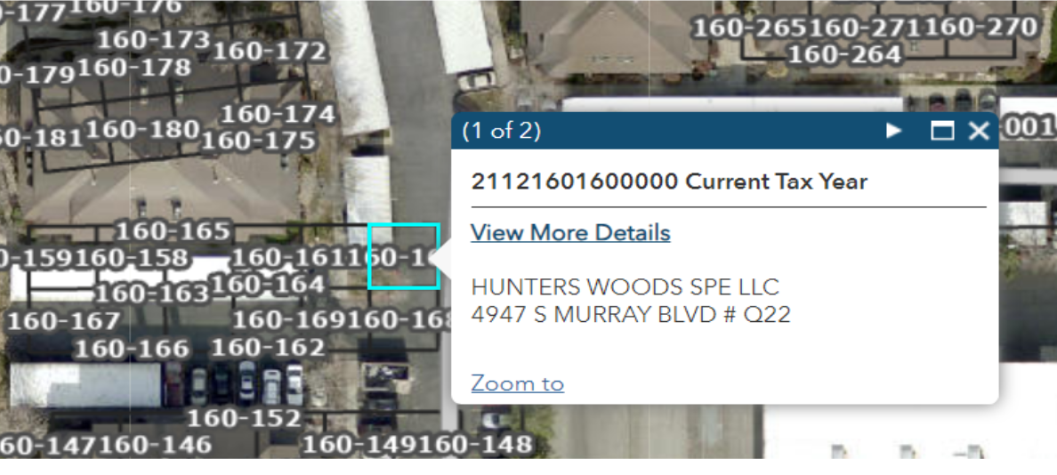
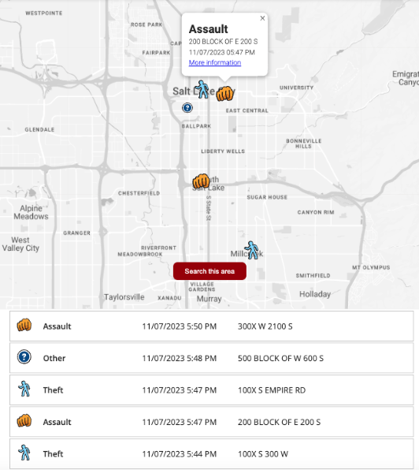
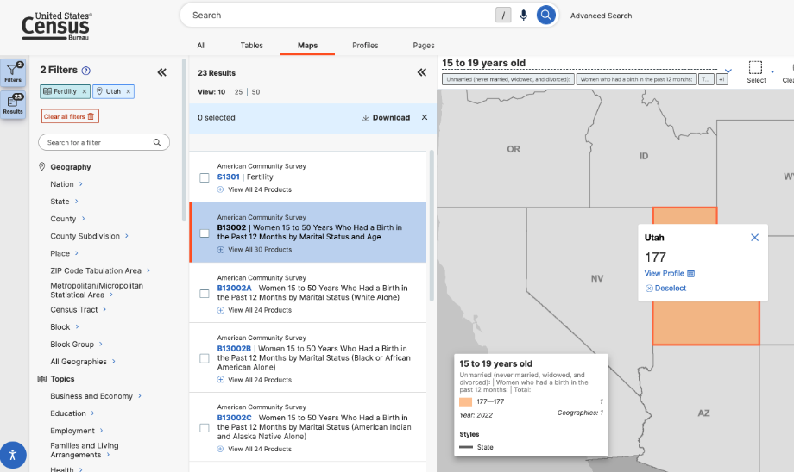
Datasets
Real Estate Owner Information
SLC Crime Report
Birth Report of Women between 15 to 50 with marital status

Slide 10
Interview Findings
Privacy Concerns
Safety Concerns
Social Concerns
ADDRESS and NAMES!
Visualization makes it easily accessible.
Utility of visualization
NAMES of victims!
Useful datasets but highly concerning if used for wrong purposes
Alerting and guiding public
Exploitation of data for political or religious purposes
Different privacy perception across different cultural background
Concerns about social stigma

Slide 11
Survey Design
No
Consent
Participant Background
Perception on public data and visualization
Open Data Initiative
Demographics
End of the survey

Slide 12
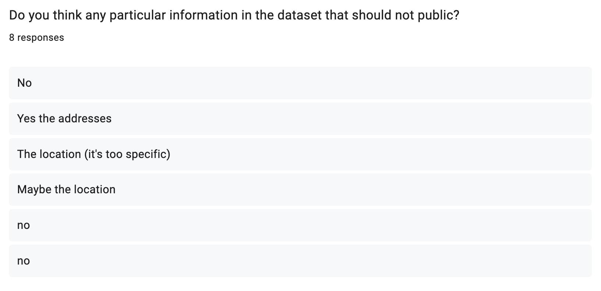
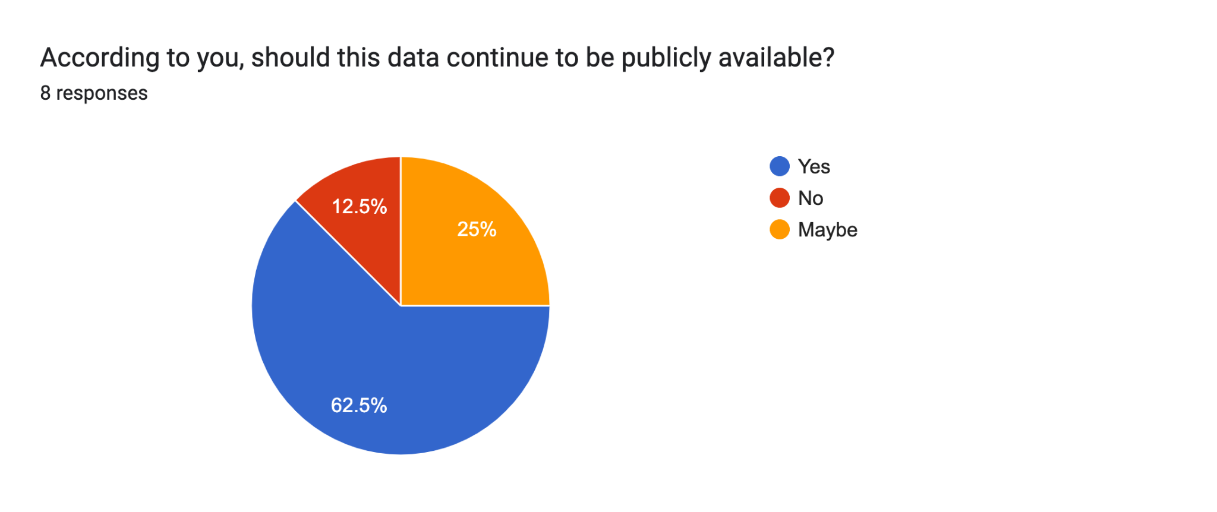
Survey Findings
LOCATION and NAME!
Continue to be public?
Highlights
- Not aware of that datasets were public
- Open Data Initiative is beneficial. But…
Hide private information.
mile-diameter metric instead of precise location.

Slide 13
Challenges
→ Interview were not diverse. Professionals or students.
→ Survey was not a suitable method
→ Hard to make any conclusions with small sample size (7 interviews and 7 participant survey)

Slide 14
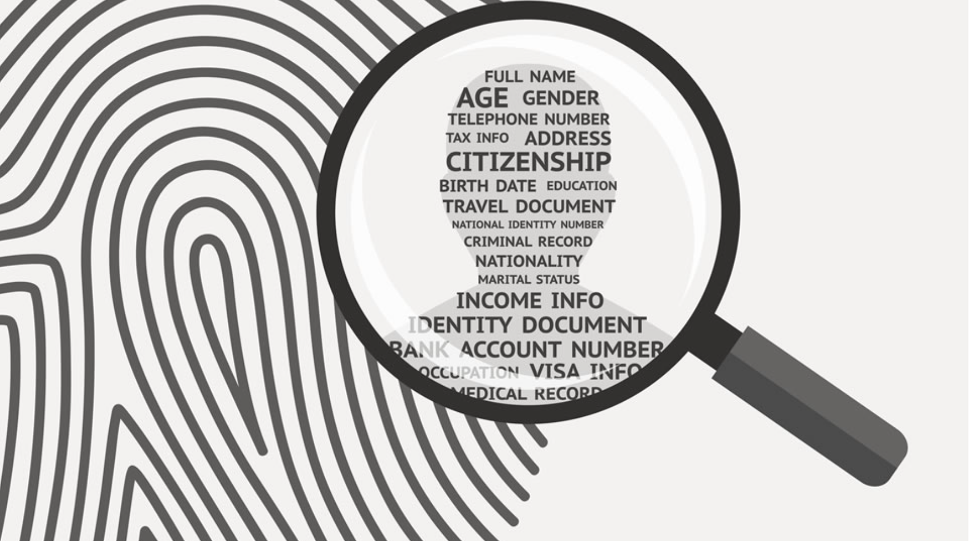
Conclusion and Future Work
Concern is REAL.
Hide private information.
Visualization HELPS!
Open Data Initiative is beneficial.
More diverse participants
More Interviews

